Slide 1

Predictive Analysis of Customer Spending Power (Customer Segmentation)
OLS and Bayesian Regression
- Team 5

Slide 2

Business Case
To predict the spending power of the target customers by understanding the trends in the dataset and predicting spending score.

Slide 3

Problem Statement
Understand the likelihood of buying or predicting the customers who are more likely to converge [Target Customers] so that marketing strategies could be designed to cater to those target customers.
Objective
Analyze the dataset to understand the dependency of spending score on available factors: Age, Annual Income, and Gender.
Create 2 models to predict spending score of the target customers (in the available dataset).
Comparative analysis of the two models (Ordinary Least Squares (OLS) with Forward Selection, and Bayesian Linear Regression with PyMC3)
Concluding on target customers from the customer base available in the dataset.

Slide 4
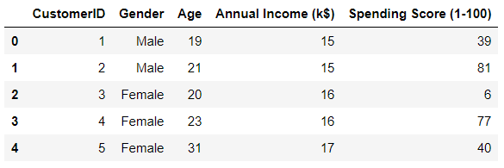
About Dataset
CustomerId: Customer's unique ID
Gender: Customer's gender
Age: Customer's age
Annual Income: Customer's annual income
Spending Score: A score, out of 100, to rate customer's behavior and money spent by the customer.
Independent Variables | Dependent Variable
Age, Annual Income, Gender | Spending Score

Slide 5
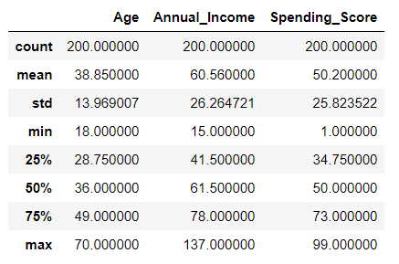
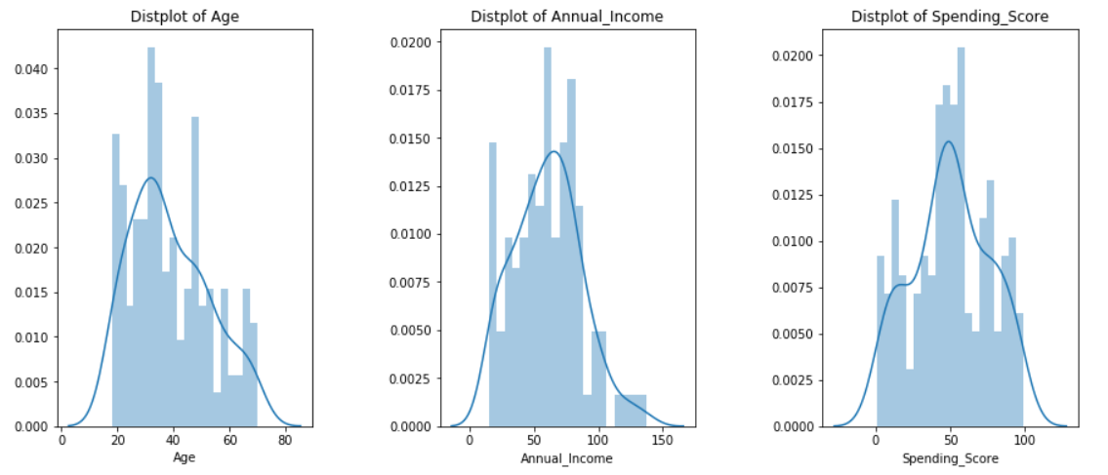
Basic statistical details of the dataset
Dependent variables and independent variables are normally distributed
Dataset looks good to conduct OLS regression
Histogram Plots

Slide 6
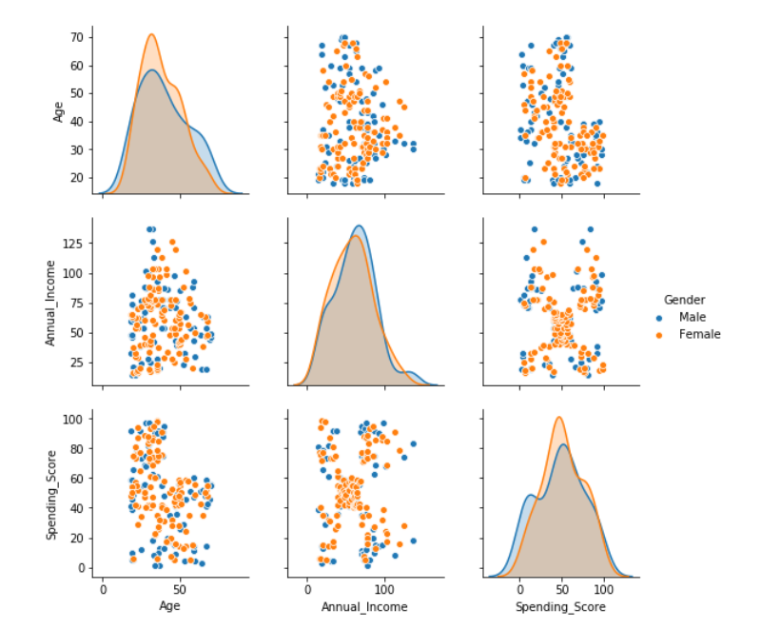
Summary observation on original dataset
We see that Age and Annual Income are not collinear.

Slide 7
Interpretations from OLS Regression on Initial Dataset
A single linear multivariate regression that models the relationship between the dependent variable and the independent variables returns a low R-squared at around 69.7%
p-value for Gender Group is high (>0.05) showing that changes in predictor variable (Gender Group) are not associated with changes in the response variable (spending score). Since, Gender Group is not a significant factor for the change in spending score, we will rerun the model after dropping GenderGroup from our model.
Intercept can be excluded as no annual income suggests no spending power/score.
Age Grouping: 6 Age Groups: Below 25, 26 – 35, 36 – 45, 46 – 55, 56 – 65, Above 65

Slide 8

Model Building
Models:
OLS with Forward Elimination
Bayesian Regression using PyMC3

Slide 9
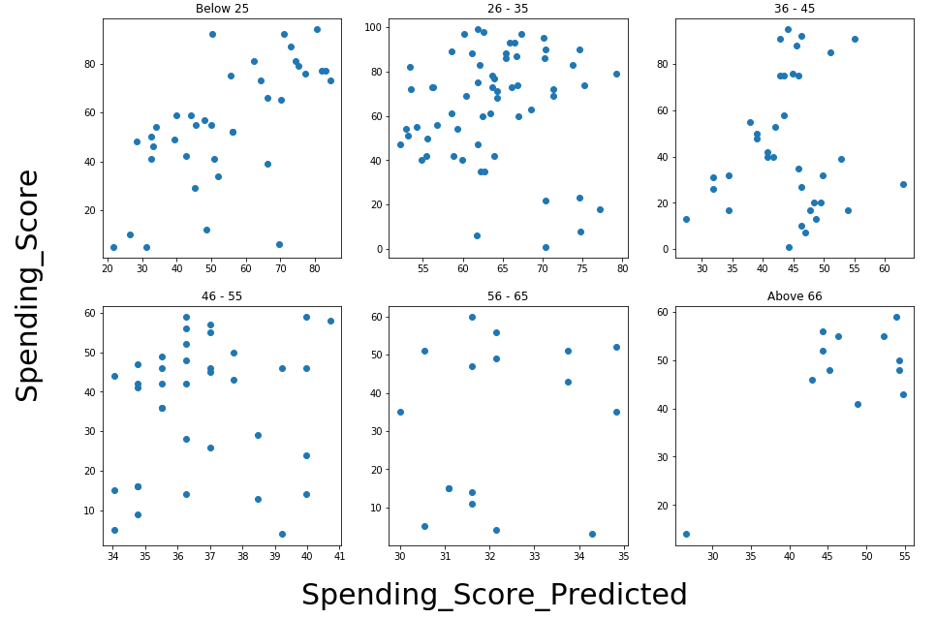
Model I – OLS using Forward Elimination
We applied a forward elimination on the linear multivariate regressions on each age group to select the combinations of independent variables that yield highest R-squared.
Predicted vs Actual Spending Score

Slide 10
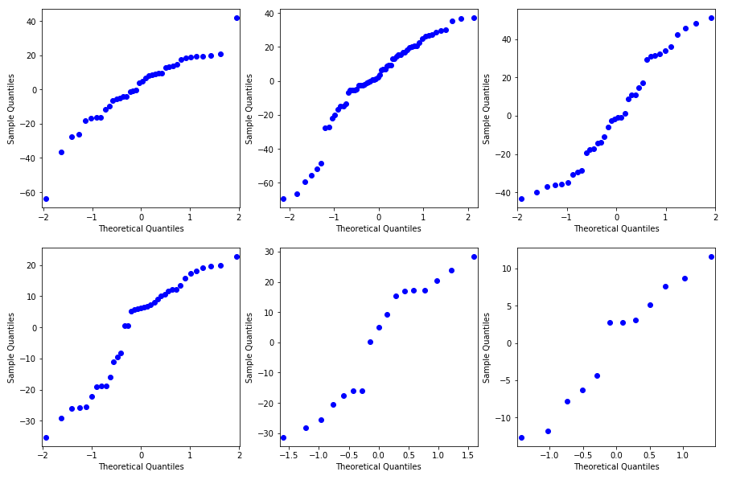
Model I – OLS using Forward Elimination
The residuals are along the diagonal, which shows normal distribution of residuals. The residuals are nearly normally distributed & centered on 0.

Slide 11
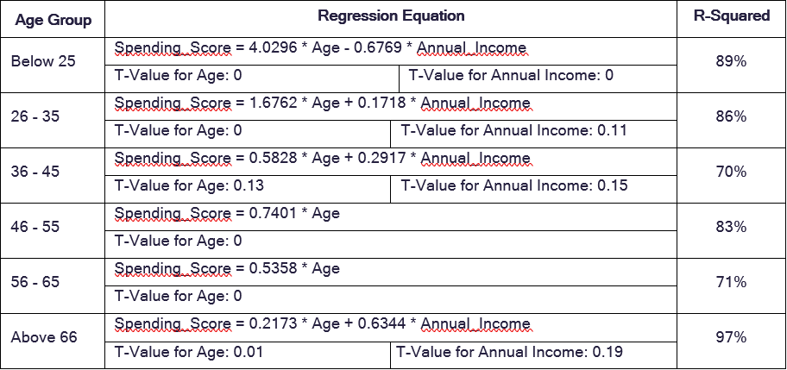
Model I – OLS using Forward Elimination Results

Slide 12



Model I - Observations
OLS with Forward Elimination
R-squared for regression on each age group improve significantly.
Some independent variables have p-value higher than 5%, suggesting that they are not a significant determinant for the spending_score. However, we argue that including those variables gives us the best predicting power as combining them with other variables yield highest R-squared.
Annual_Income is negatively correlated with the spending_score for customers below 25.
Annual_Income does not seem to have any relationship with the spending_score for customers between 46 years old to 65 years old.
There are not many data points for the age group above 56 (56-65 and above 66). Therefore, the regression results in these two groups could change significantly with more data collection.

Slide 13
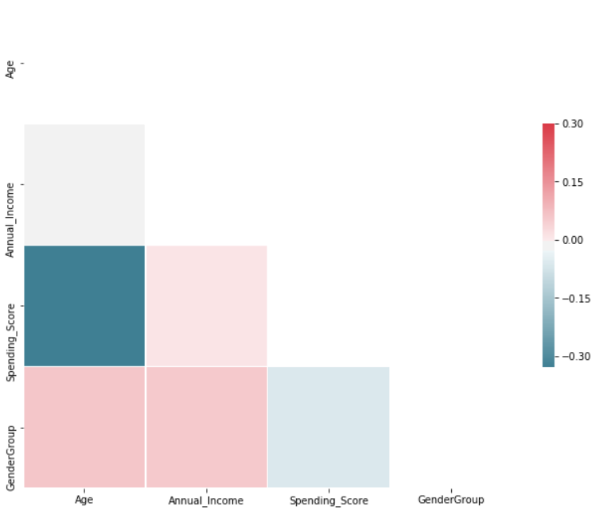
Model II – Bayesian Linear Regression using PyMC3
We did Regression modelling in the Bayesian framework and carried out inference using the PyMC3 MCMC library.
We do this primarily because:
We have a limited dataset
Some facts may be more likely than others, but that information may not be contained in the data we are using for modeling.
We are interested in knowing how likely certain facts are
Heatmap

Slide 14
Model II – Create Model in PyMC3 and Sample from Posterior
We built the model using the formula 'Spending_Score ~ Age + Annual_Income' as evident from heat map, and a normal distribution for the data likelihood. Then, we let a Markov Chain Monte Carlo algorithm draw samples from the posterior to approximate the posterior for each of the model parameters. We let GLM module from PYMC3 to choose default priors.
The sampling algorithm chosen by PYMC3 module is NUTS sampler i.e. No U-turn Sampler.
We draw 20000 sample with 2 chains and run the GLM model for the formula: Spending_Score ~ Age + Annual_Income -1. We remove the intercept.
We run this algorithm with 6 age groups as identified before (below 25, 26 – 35, 36 – 45, 46 – 55, 56 – 65, Above 65) and compared the results obtained.

Slide 15
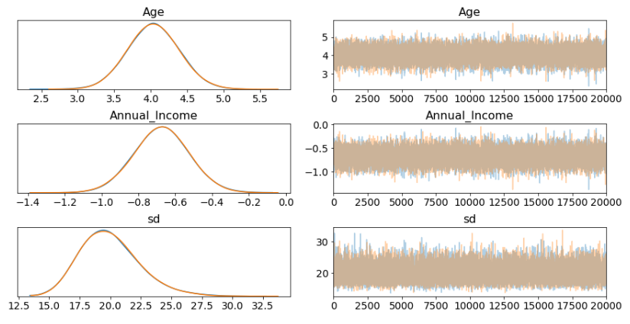
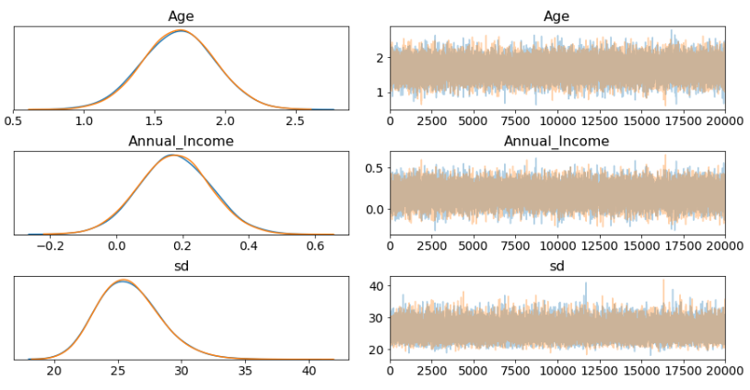
Model II – Examining Bayesian Linear Regression Results
The left side of the traceplot is the marginal posterior: the values for the variable are on the x-axis with the probability for the variable (as determined by sampling) on the y-axis. The different colored lines indicate that we performed two chains of Markov Chain Monte Carlo. From the left side we can see that there is a range of values for each weight. The right side shows the different sample values drawn as the sampling process runs.
Age Group: Below 25
Age Group: 26 - 35

Slide 16
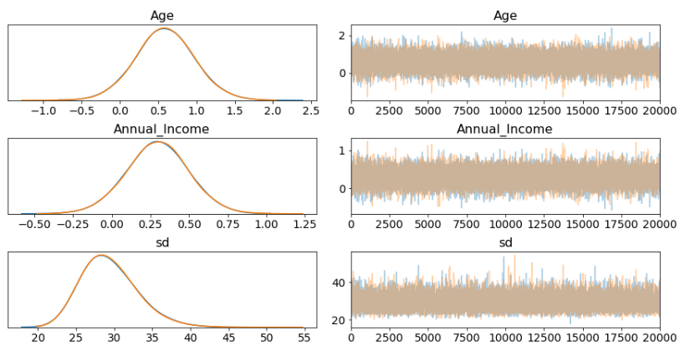
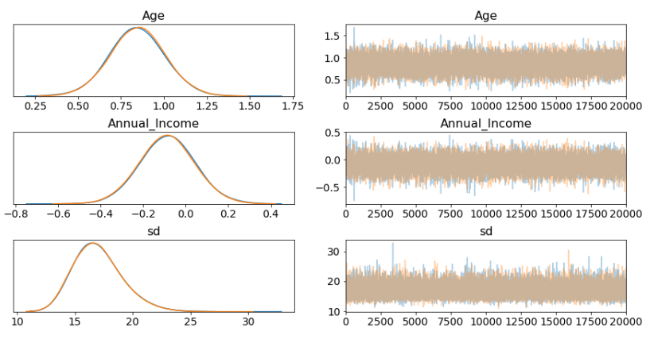
Model II – Examining Bayesian Linear Regression Results
Age Group:
36 - 45
Age Group: 46 - 55

Slide 17
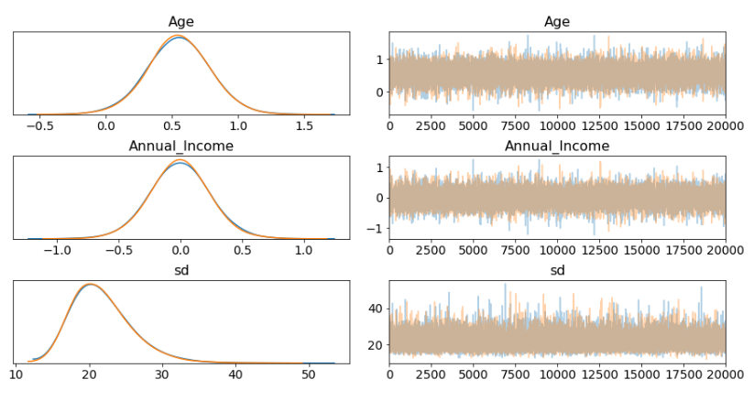
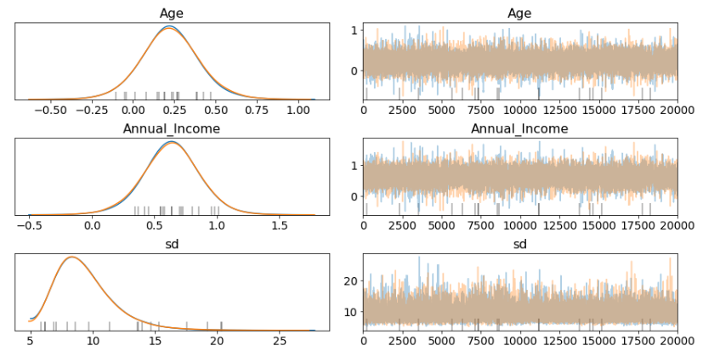
Model II – Visualizing trace plots
Age Group:
56 - 65
Age Group: Above 65

Slide 18
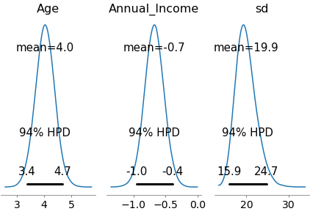
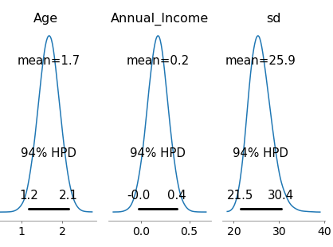
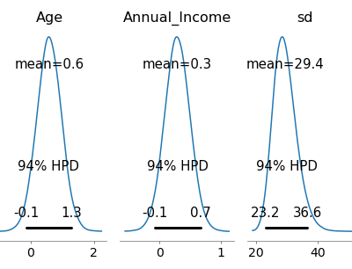
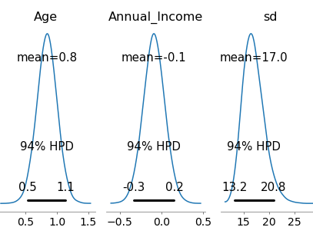
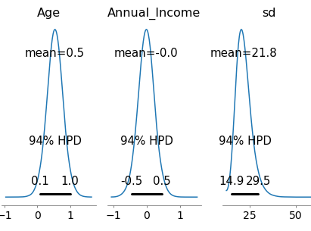
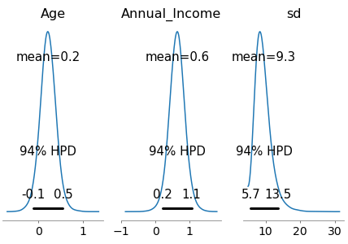
Model II – Examining Bayesian Linear Regression Results
Age Group: Below 25
Age Group: 26 - 35
Age Group: 36 - 45
Age Group: 46 - 55
Age Group: 56 - 65
Age Group: Above 65

Slide 19
Model II - Interpretations of Weights
Bayesian Linear Regression
Based on the sign and location of the weights, we can make the following inferences regarding the features in our dataset:
Based on Agegroup, Below 25, Age seems to have positive relation with spending score while Annual income has negative impact.
In Agegroup between 26-45, both Age and Annual income has postive impact on spending score.
When we go further down the age group with ages 56-65, we see a positive impact of age on spending score while annual income is negative.
In Agegroup, above 66, both the factors has positive impact on age.

Slide 20
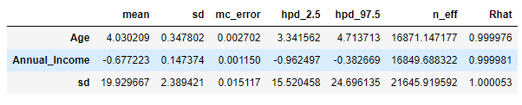
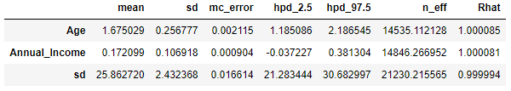
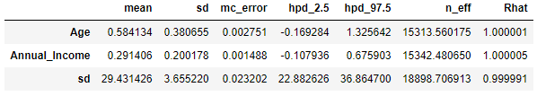
Model II – Summary of MCMC Model for Different Age Groups
Age Group: Below 25
Age Group: 26 - 35
Age Group: 36 - 45
Age Group: 46 - 55
Age Group: 56 - 65
Age Group: Above 65

Slide 21
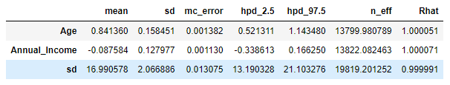
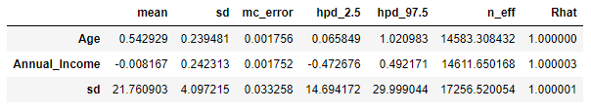
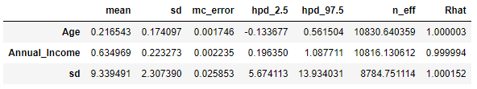
Model II – Summary of MCMC Model for Different Age Groups
Age Group: 46 - 55
Age Group: 56 - 65
Age Group: Above 65

Slide 22
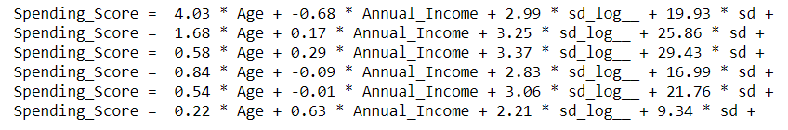
Model II – Summary of MCMC Model for Different Age Groups
Below 25:
26 – 35:
36 – 45:
46 – 55:
56 – 65:
Above 65:

Slide 23
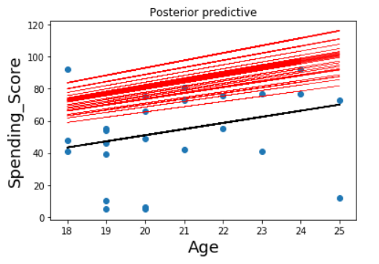
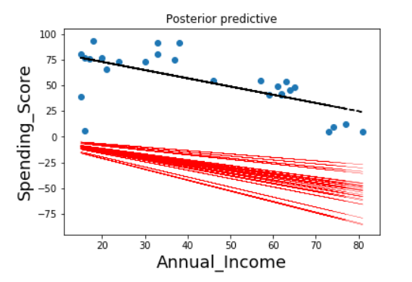
Model II – Prediction of Response
We create the posterior plots which provide insight into the sample’s posterior predictive regression lines.
Red line is Bayesian Regression lines. Black lines show linear regression lines. Blue dots are the data points.
Age Group: Below 25

Slide 24
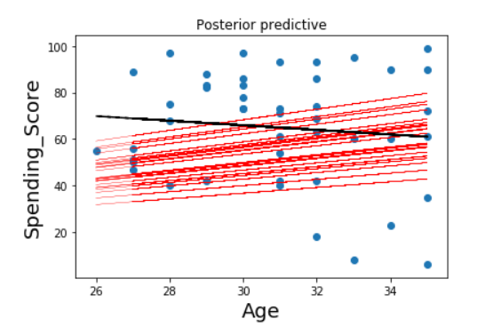
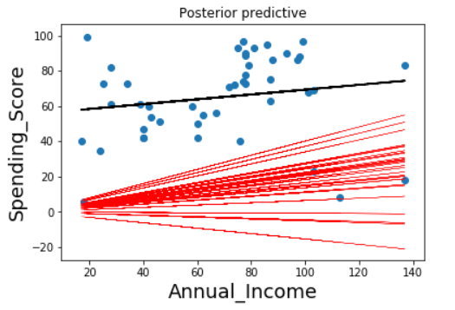
Model II – Prediction of Response
We create the posterior plots which provide insight into the sample’s posterior predictive regression lines.
Age Group: 26 - 35

Slide 25
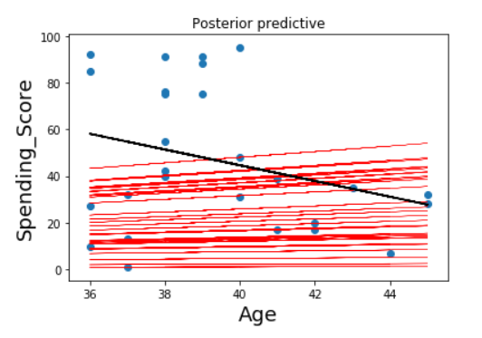
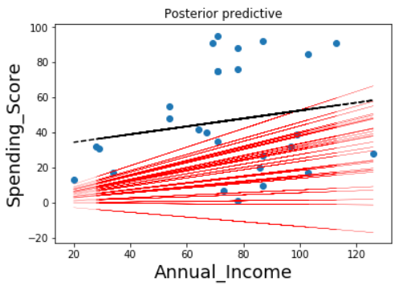
Model II – Prediction of Response
We create the posterior plots which provide insight into the sample’s posterior predictive regression lines.
Age Group: 36 - 45

Slide 26
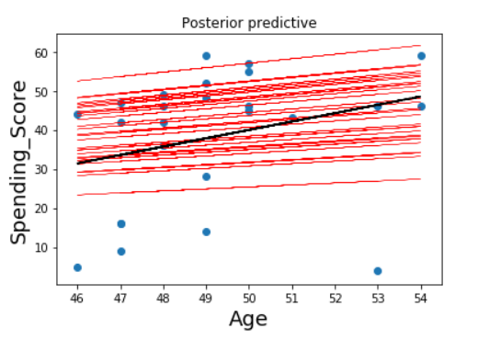
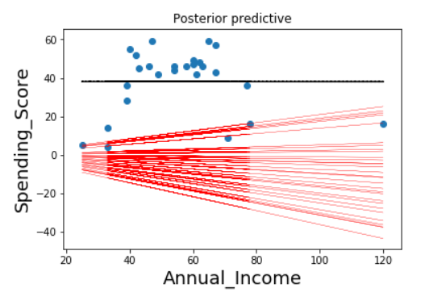
Model II – Prediction of Response
We create the posterior plots which provide insight into the sample’s posterior predictive regression lines.
Age Group: 46 - 55

Slide 27
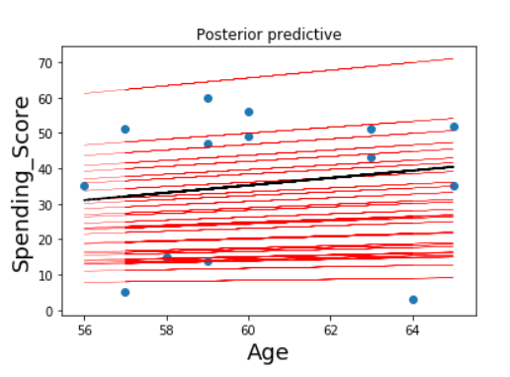
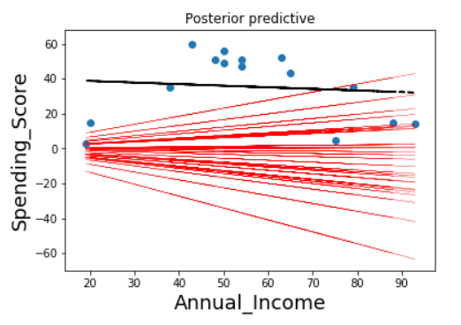
Model II – Prediction of Response
We create the posterior plots which provide insight into the sample’s posterior predictive regression lines.
Age Group: 56 - 65

Slide 28
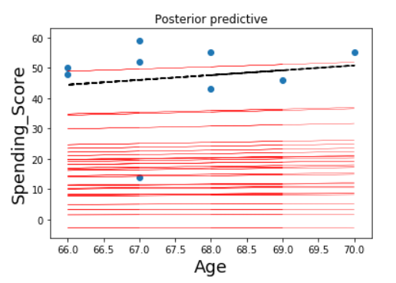
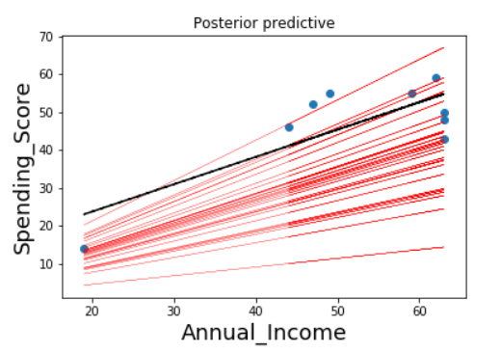
Model II – Prediction of Response
We create the posterior plots which provide insight into the sample’s posterior predictive regression lines.
Age Group: Above 65

Slide 29
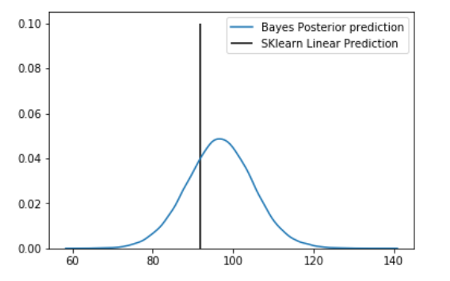
Model II – Prediction for Single Point
Below is the point prediction (for Age = 23, using Bayesian Regression. We see that Bayesian prediction mean value almost coincides with the linear regression output. The data should be rich enough to predict correctly.

Slide 30
Comparison of the two models results
OLS with Forward Regression
Bayesian Regression

Slide 31
Thank You
Anshita Varshney
Bhavnil Patel
Chongli Zhao
Dhairya Sheth
Jyoti Lnu
Ruofan Wu

Slide 32
References
https://towardsdatascience.com/markov-chain-monte-carlo-in-python-44f7e609be98
https://www.quantstart.com/articles/Bayesian-Linear-Regression-Models-with-PyMC3
https://www.quantstart.com/articles/Markov-Chain-Monte-Carlo-for-Bayesian-Inference-The-Metropolis-Algorithm
https://towardsdatascience.com/bayesian-linear-regression-in-python-using-machine-learning-to-predict-student-grades-part-2-b72059a8ac7e
http://people.duke.edu/~ccc14/sta-663-2016/16C_PyMC3.html
https://people.duke.edu/~ccc14/sta-663/PyMC3.html

